Slide 1
DealFinder
Mock UI
GROUP 2
Presented By : Mashiat Mustaq (1705005)

Slide 2
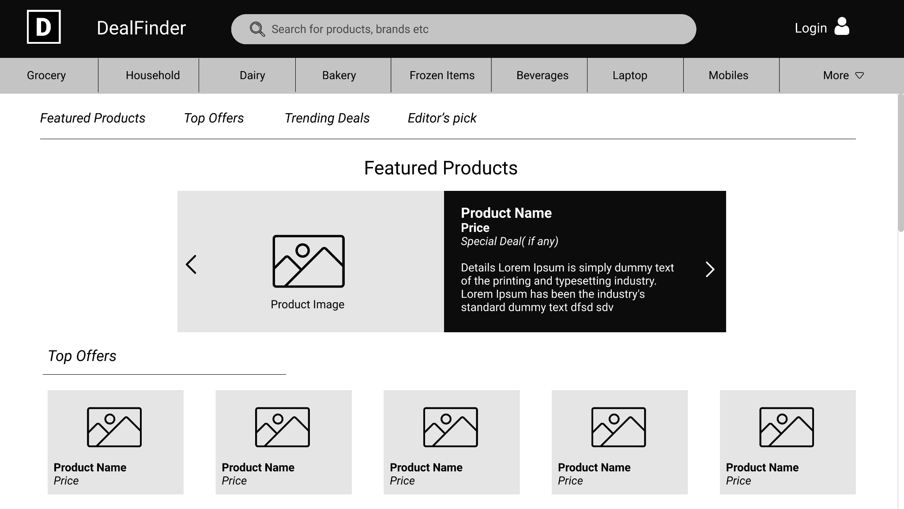
Homepage

Slide 3
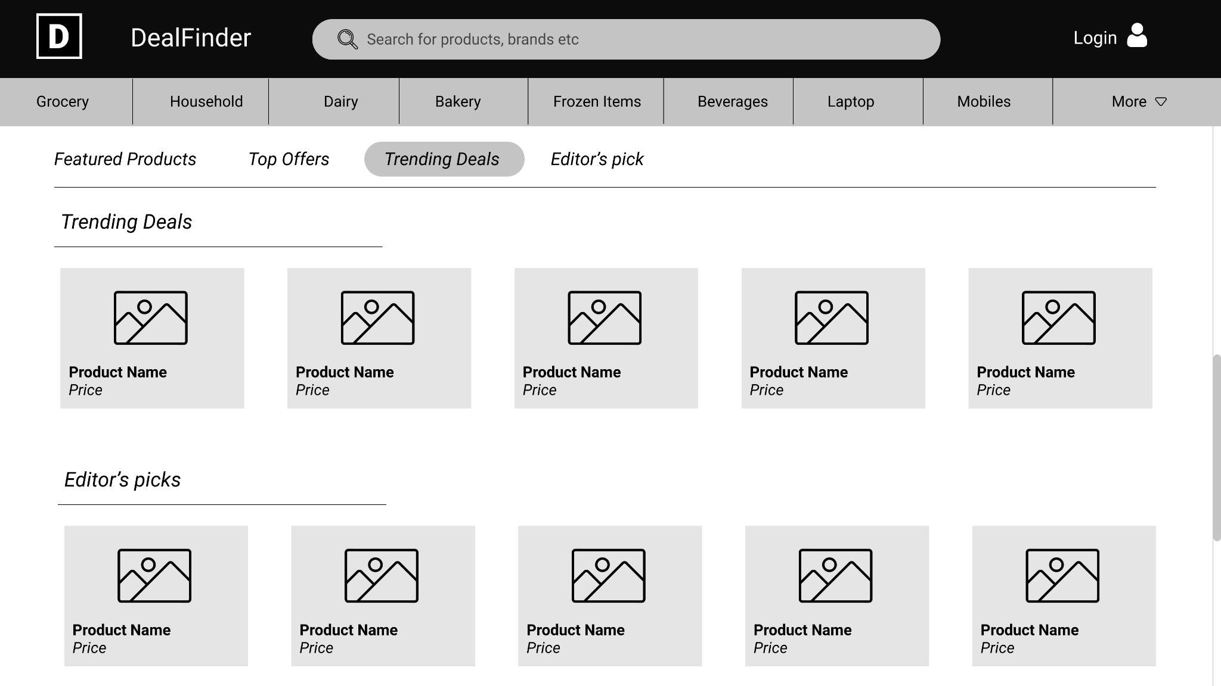
Homepage

Slide 4
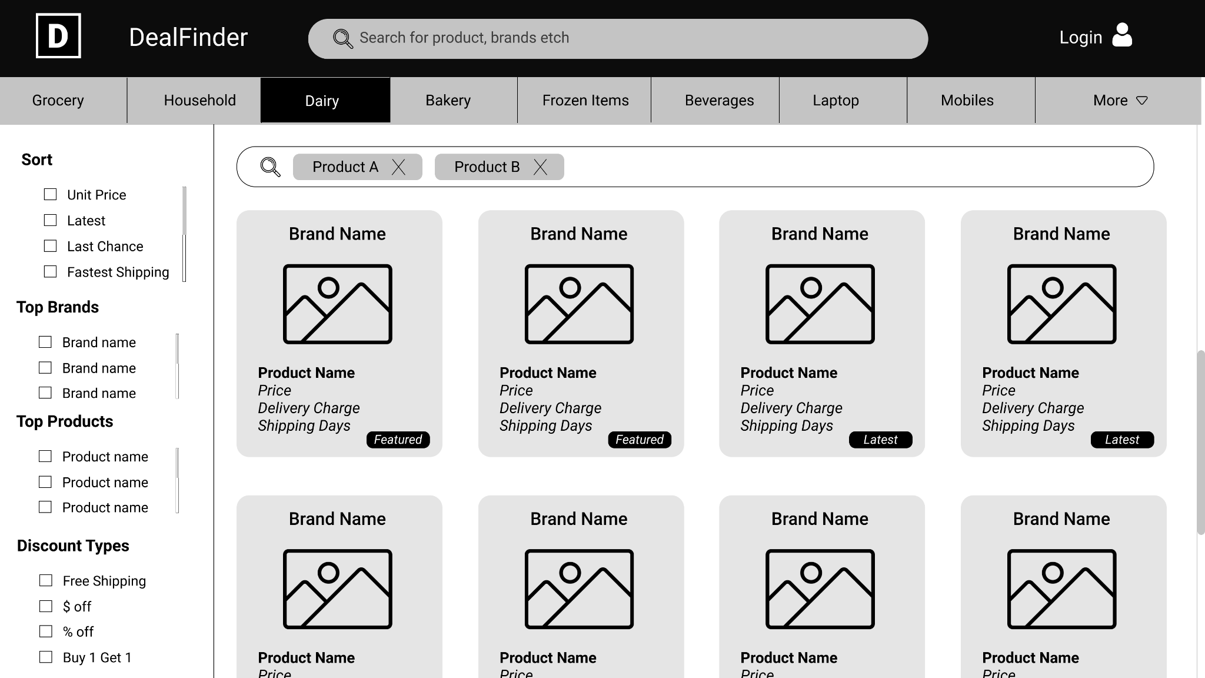
Category Search

Slide 5
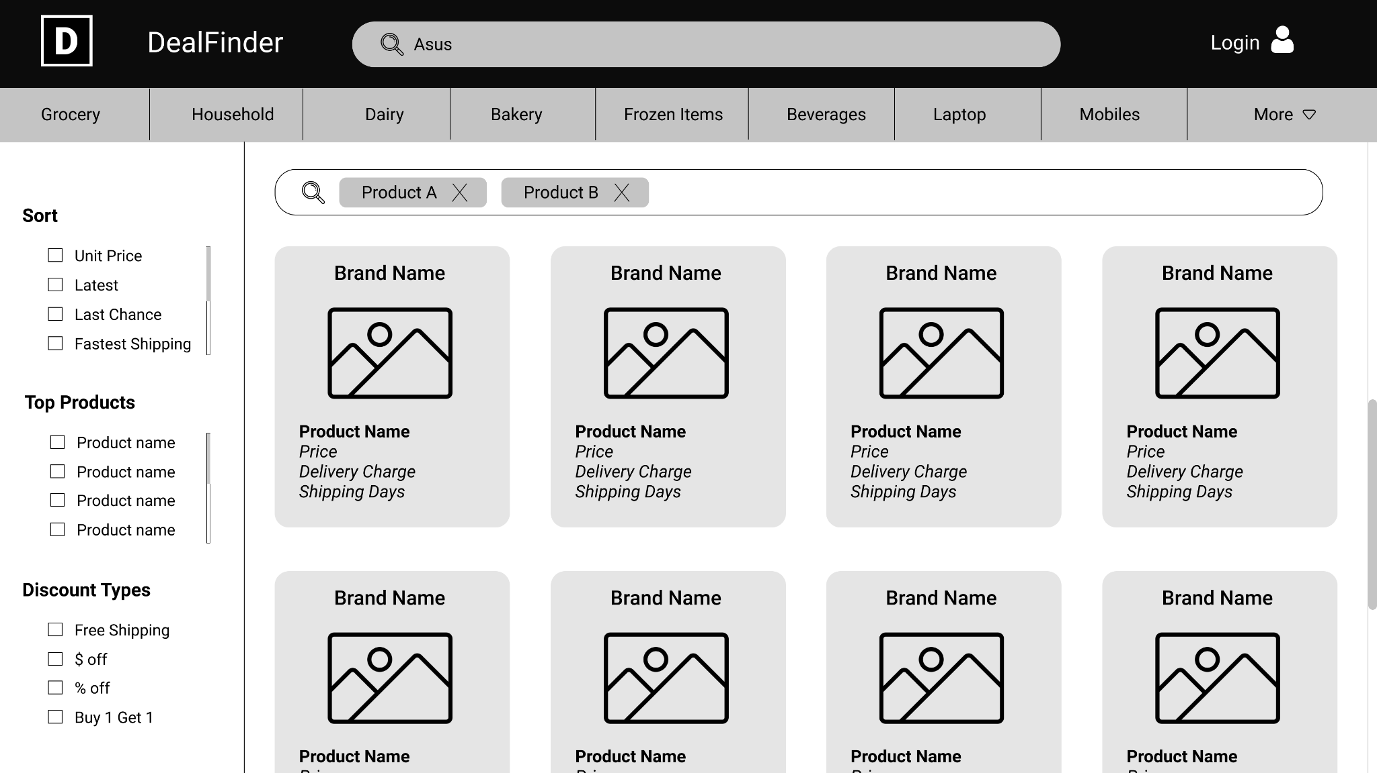
Brand Search

Slide 6
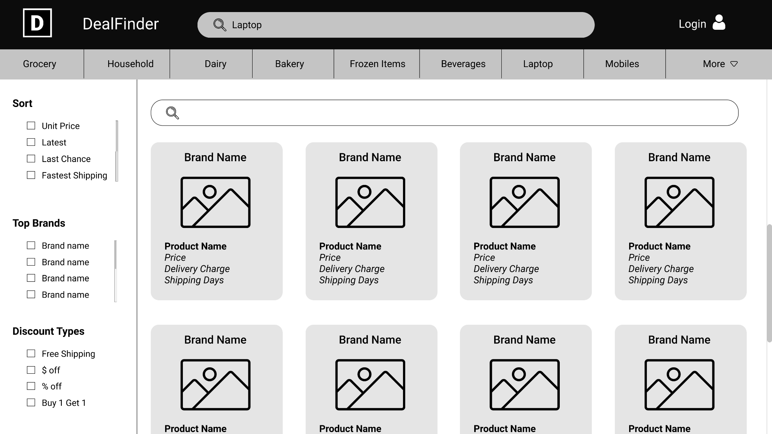
Product Search

Slide 7
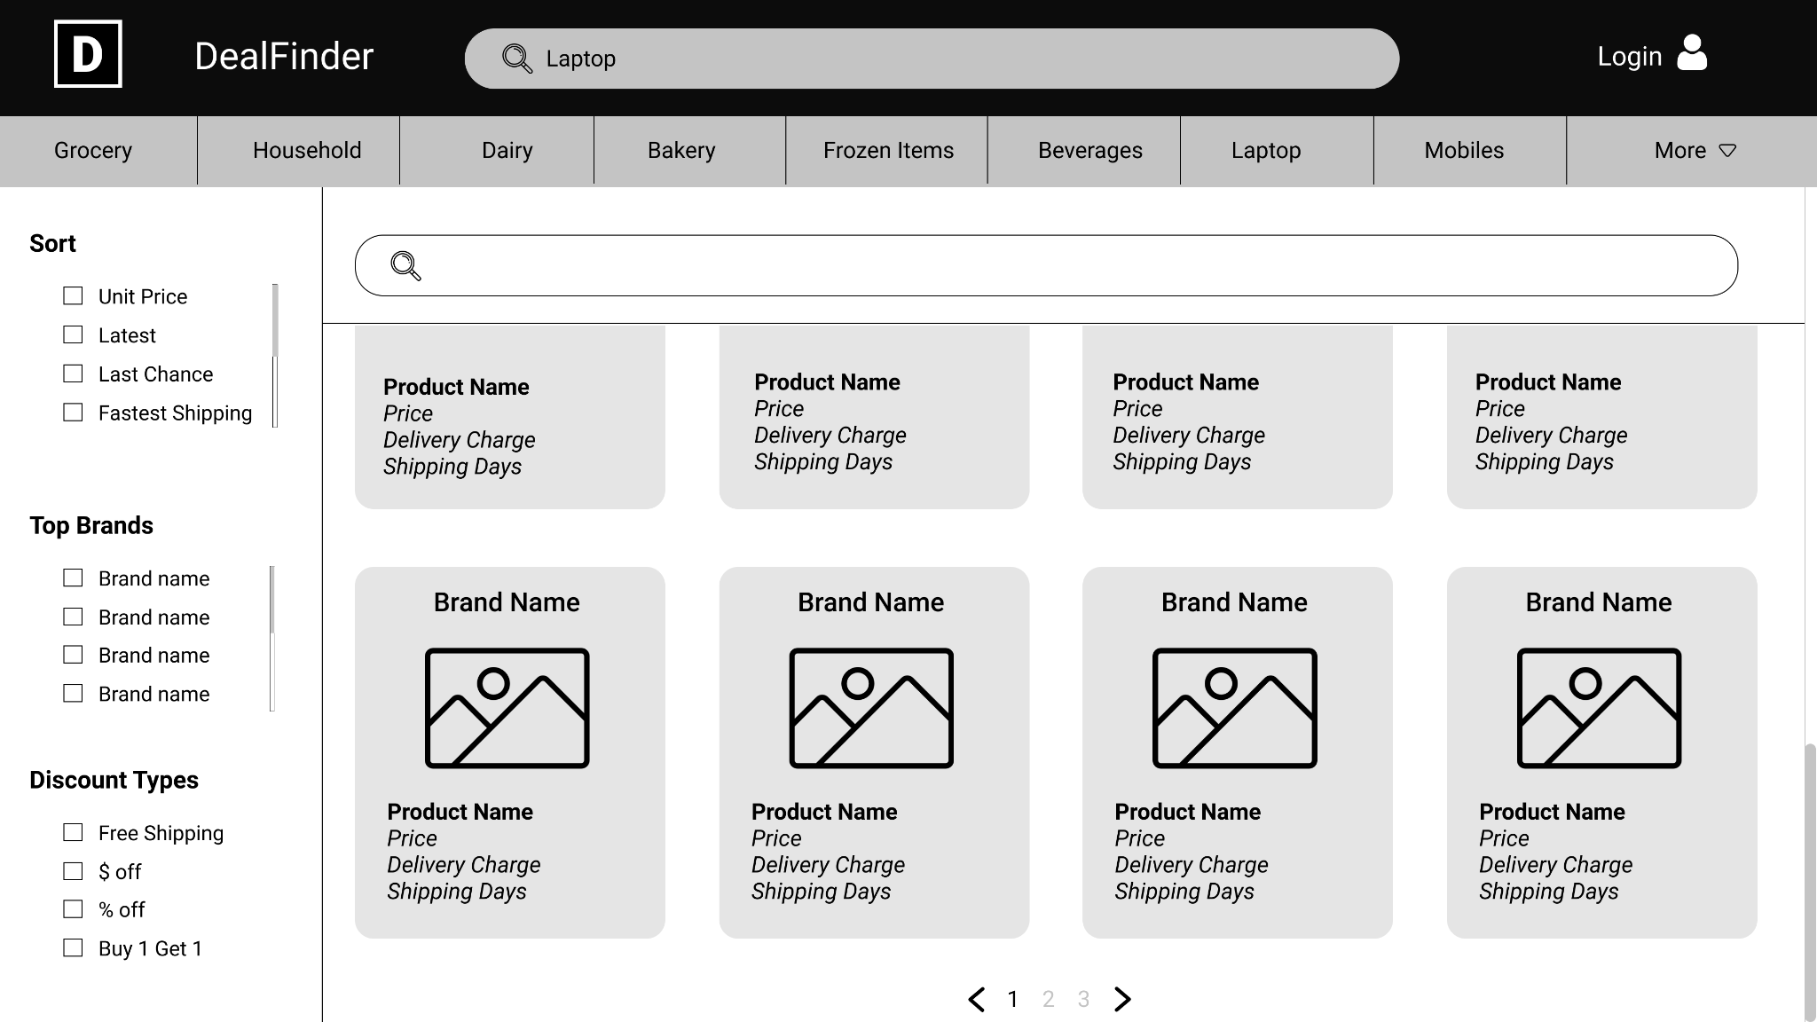
Product Search

Slide 8
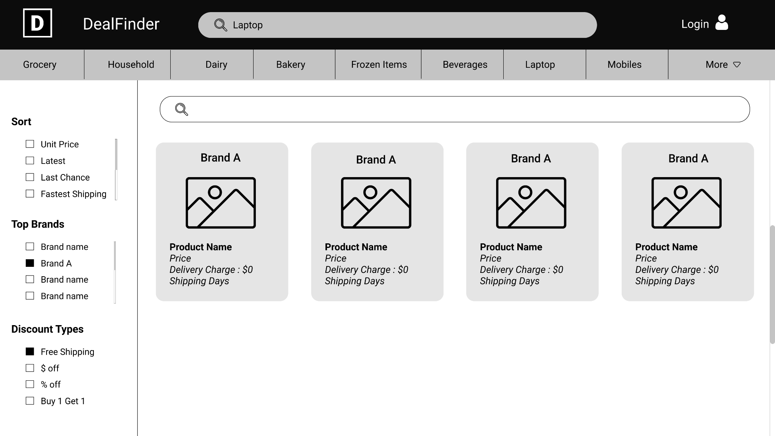
Filtered Search

Slide 9
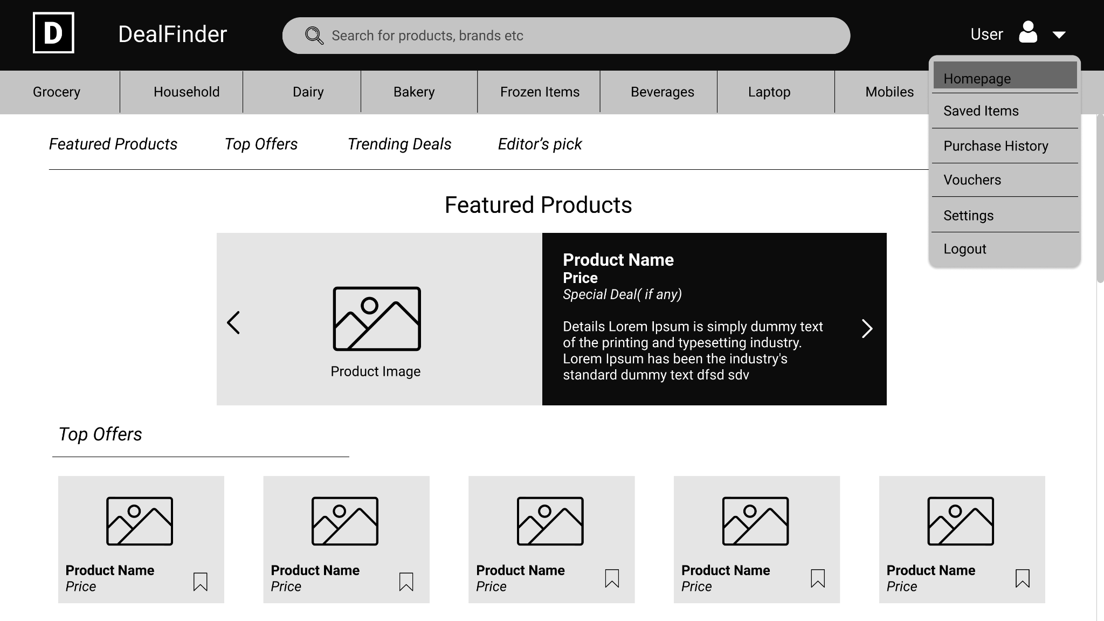
Logged in

Slide 10
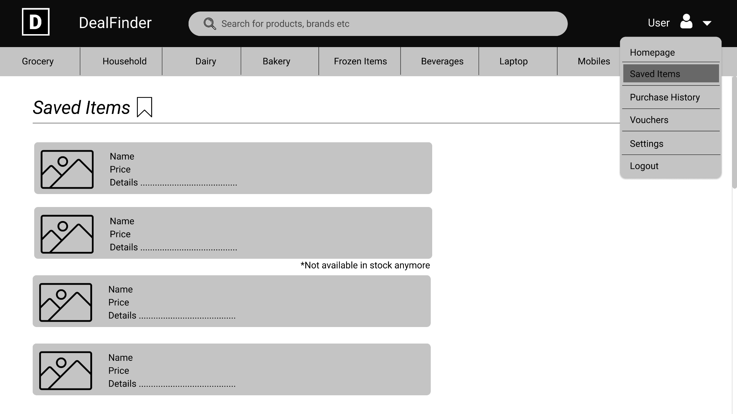
Saved Items

Slide 11
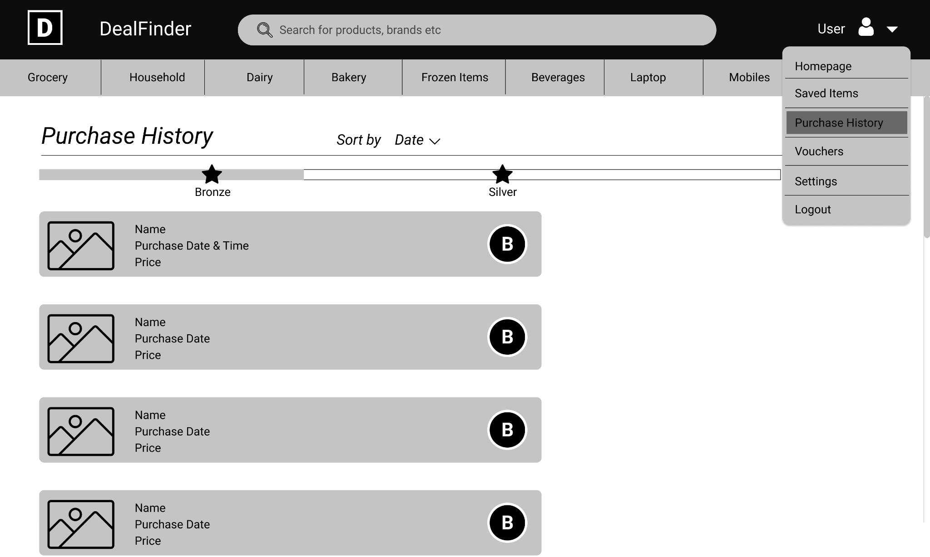
Purchase History

Slide 12
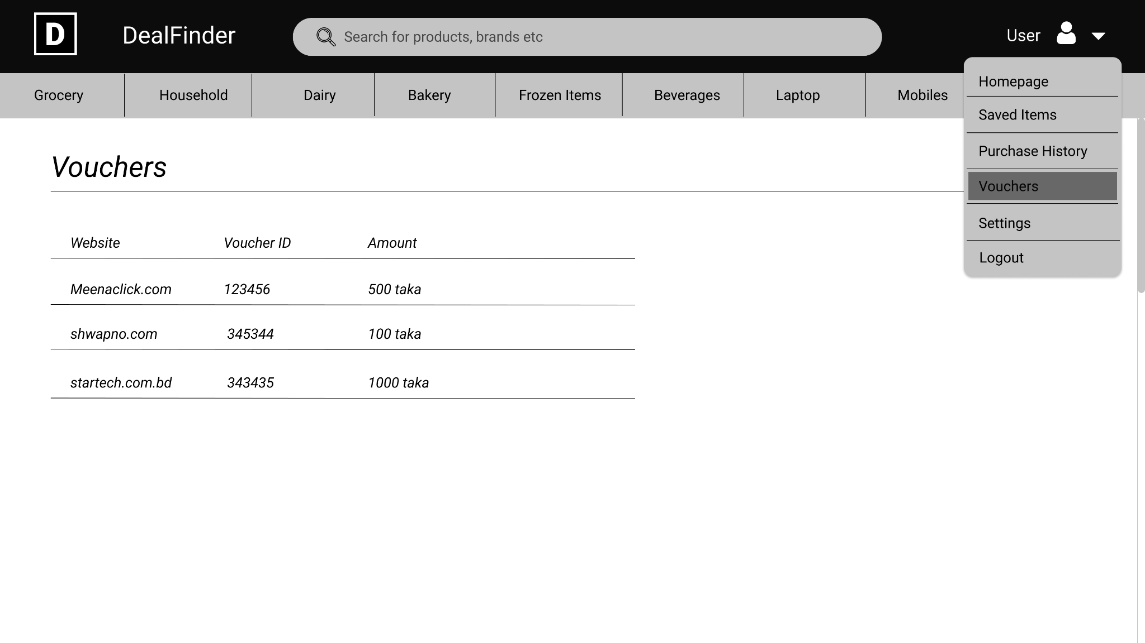
Vouchers

Slide 13
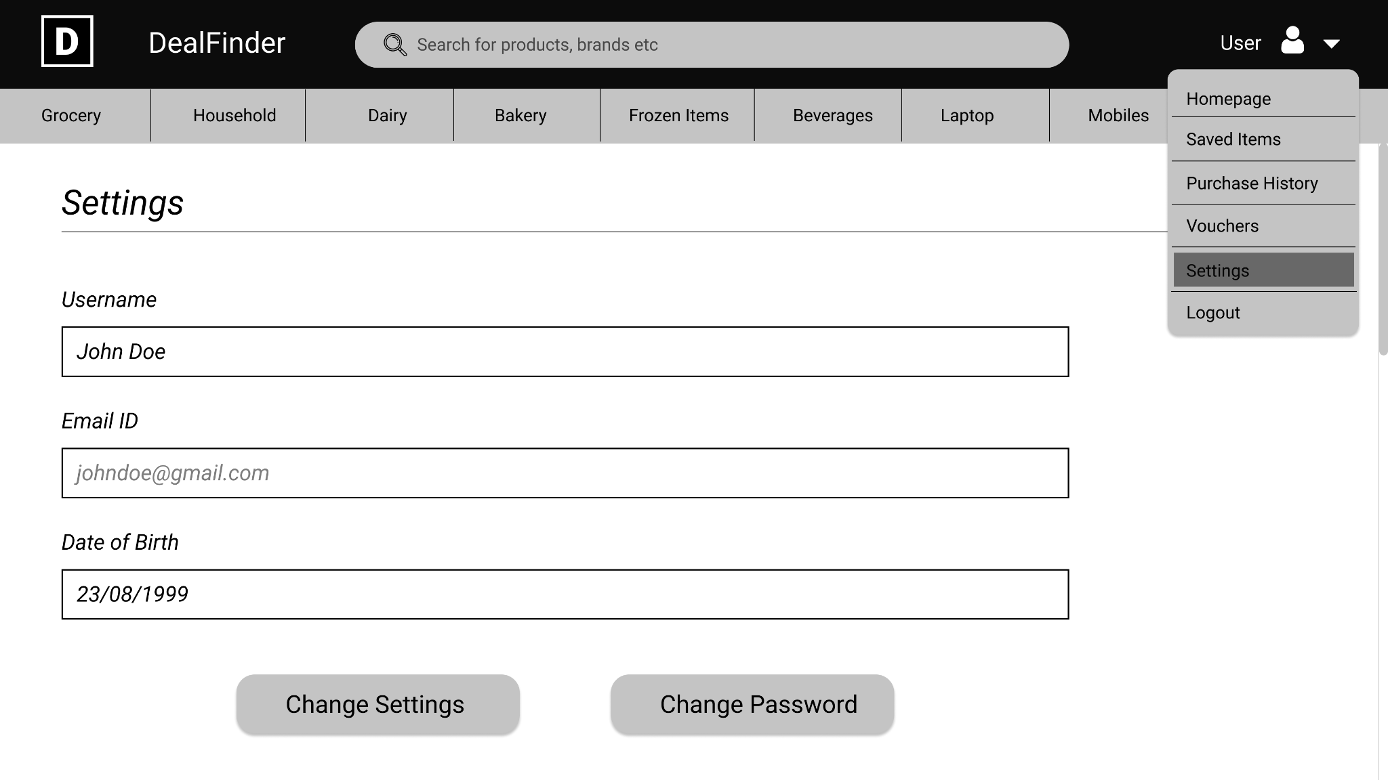
Settings

Slide 14
THANK YOU

